Slide 1



Slide 2
Theta is a new technology in nutrition.
With this technology it is possible to experience benefits within only minutes of use.

Slide 3
The global nutrition market was $142 Billion annually in 2011, and continues to expand.
Imagine what you can do with your business with a market of this size, and a health technology that is exclusive to LifeWave.

Slide 4
THE CONCEPT

Slide 5
THE CONCEPT
Introduce a new generation of nutritional supplements that produce real, noticeable results in as short a period of time as possible

Slide 6
THE PRODUCTS

Slide 7




NATURAL PRODUCTS
- No stimulants - No artificial sweeteners
- No artificial colors - No preservatives
- No artificial flavors - No GMO’s, no gluten

Slide 8
THE PRODUCT LINE

Slide 9

THE PRODUCT LINE
“Mission specific” formulas that address real human needs and provide real answers to peoples health concerns

Slide 10
THE SCIENCE

Slide 11

THE SCIENCE
All formulas are provided in a stick pack
as a powder, dissolved in water and
then “activated”
A special, novel catalyst “turbocharges”
nutrient delivery for superior utilization

Slide 12
THE EXPERIENCE

Slide 13

THE EXPERIENCE
Because these products are
activated for superior nutrient
absorption, a person will feel
the effects of our nutrition
products, most within just
minutes of use

Slide 14
THE RESULTS

Slide 15

THE RESULTS
Because more of the nutrients
are being absorbed into the cells,
we can expect that the long term
benefits will be superior as well

Slide 16
THE FIT

Slide 17
THE FIT
The theta formulas have been designed to compliment our line of patch products
The theta formulas provide unique benefits
Consuming theta improves a persons experience with LifeWave patches

Slide 18
THE MARKET

Slide 19

THE MARKET
With over 60% of the network marketing
industry purchasing supplements, we now
have access to this multi-billion dollar
industry with a completely unique,
more effective approach

Slide 20
THE FOCUS

Slide 21
THE FOCUS
Because of the simplicity of this new product line, members will find it easier to build their LifeWave business more rapidly than ever before

Slide 22
THE HOME PARTIES

Slide 23
THE HOME PARTIES
Theta is the perfect product for home parties and demonstrations
All formulas taste great, come in single serve stick packs, nothing artificial, provide superior nutrition, and people feel it within minutes.
This is a dynamic formula for business success!

Slide 24
THE AUTOSHIPS

Slide 25

THE AUTOSHIPS
As consumable products, you are now able to offer
more variety for your customers.
You have the opportunity to increase
the number of autoships, and the
dollars spent

Slide 26
THE EXPANSION

Slide 27

THE EXPANSION
The initial launch of theta is in the USA.
The European union will launch in April.
Other countries to launch later this year.

Slide 28
THE EXPANSION
New Theta formulas will be released in April and September of this year.
This will give us the opportunity to promote new products during the year, creating more revenue opportunities.

Slide 29
THE FIRST
THETA FORMULA

Slide 30


Slide 31
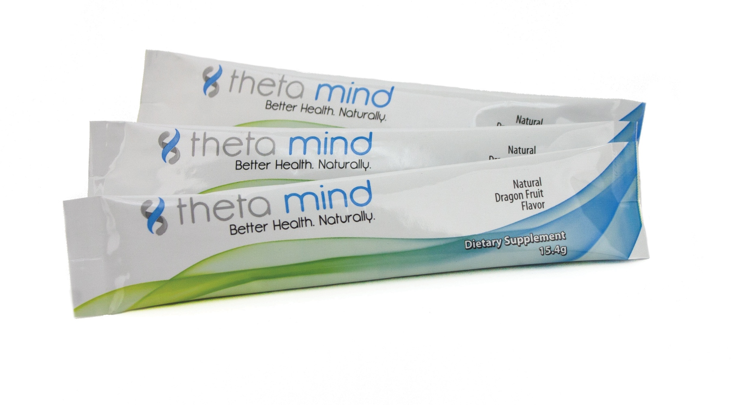
The difference between your success and failure in life can depend on how well your brain performs.

Slide 32
Theta Mind offers nutrition that promotes dramatic increases and improvements in memory, focus and
even learning

Slide 33
Activated Nutrient System for Rapid Results
Supports Focus, Attention and Memory
Designed to Promote Superior Cognitive Function

Slide 34


DMAE
citicoline
Theta Mind has been designed to support brain production and release of acetylcholine, an important neurotransmitter involved in learning and memory, by converging pathways from multiple directions.
alpha GPC,
phosphatidylserine

Slide 35
Cognizin – elevates acetylcholine, the nutrient responsible for memory and learning
DMAE – clinically shown to improve memory and focus
Alpha GPC – contributes to acetylcholine production
Phosphatidyl Serine – brain chemistry; enhances mood
Nutriose – functional fiber for proper absorption

Slide 36
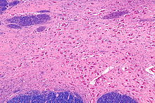

What is acetylcholine?
Acetylcholine has functions both in the peripheral nervous system (PNS) and in the central nervous system (CNS) as a neuromodulator.
In the peripheral nervous system, acetylcholine activates muscles, and is a major neurotransmitter in the autonomic nervous system.
In the central nervous system, acetylcholine and the associated neurons form a neurotransmitter system, the cholinergic system, which tends to cause anti-excitatory actions

Slide 37
What is acetylcholine?
One well-supported function of acetylcholine (ACh) in cortex is increased responsiveness to sensory stimuli, a form of attention
Some forms of learning and plasticity in cortex appear dependent on the presence of acetylcholine
And of great importance are numerous studies that support the observation that increases in brain levels of acetylcholine improve persons memory and ability to learn.

Slide 38
Cognizin – elevates acetylcholine, the nutrient responsible for memory and learning
Your brain makes up only 2% of your body weight, yet it consumes roughly 20% of your body’s energy when at rest. That means the human brain needs a whole lot of nutrition to stay alert and focused throughout the day.”
Cognizin elevates acetycholine, keeping the brain’s energy-producing centers firing. Clinically tested for efficacy, Cognizin® supplies your brain with the energy it needs to stay sharp.

Slide 39
DMAE – clinically shown to improve memory and focus
(Dimethylaminoethanol)
DMAE is an amino acid which is found in small amounts in the brain. According to studies, DMAE is a crucial substance that functions as a building block for choline, which allows the brain to manufacturer acetylcholine.
DMAE is an organic compound that is produced in the human brain and is also found in fish like anchovies, salmon, and sardines.
Choline is used by the body for many important functions, which include cell membrane integrity and the healthy functioning of neurotransmitters Both DMAE and choline promote optimal functioning of memory and also enhance learning abilities.
DMAE and choline also promote oxygen levels in the blood, which help to boost circulation and promote healthy cell functioning both in the brain and in other parts of the body.

Slide 40
DMAE – clinically shown to improve memory and focus
(Dimethylaminoethanol)
- Boosting memory and brain power
- Improving and elevating moods;
- Boosting athletic performance;
- Slowing the body's production of arachidonic acid, which leads to wrinkles and signs of aging of the skin.

Slide 41
Alpha GPC – contributes to acetylcholine production
(L-Alpha Glycerylphosphorylcholine)
Alpha GPC is a natural choline compound found in the brain and in milk. It is also a acetylcholine precursor and is used to enhance memory and cognition.
An Italian multicentre clinical trial on 2,044 patients suffering from recent stroke were supplied alpha-GPC in doses of 1,000 mg/day for 28 days and 400 mg three times per day for the five ensuing months. The trial confirmed the therapeutic role of alpha-GPC on the cognitive recovery of patients based on four measurement scales, three of which reached statistical significance.
In short:
- Enhancing brain function and memory in healthy adults
- Improving learning ability and thinking skills

Slide 42
Phosphatidyl Serine – brain chemistry; enhances mood
In recent studies, PS has been shown to enhance mood during mental stress and to improve accuracy during tee-off by increasing the stress resistance of golfers.
Phosphatidylserine has also been demonstrated to speed up recovery, prevent muscle soreness, improve well-being, and might possess ergogenic properties in athletes involved in cycling, weight training and endurance running.
PS, in a dose dependent manner (400 mg), has been reported to be an effective supplement for combating exercise-induced stress by blunting the exercise-induced increase in cortisol levels.
PS supplementation promotes a desirable hormonal balance for athletes and might attenuate the physiological deterioration that accompanies overtraining and/or overstretching.

Slide 43
Nutriose – functional fiber for proper absorption
NUTRIOSE® is a soluble fiber (dextrin) derived from natural sources
- A nutritional supplement, high in fiber, low in calories.
- A prebiotic that delivers a well-regulated appetite and metabolism.

Slide 44
What could you accomplish with Theta Mind?

Slide 46
THE NEXT
THETA FORMULA
IS…

Slide 47


Slide 48
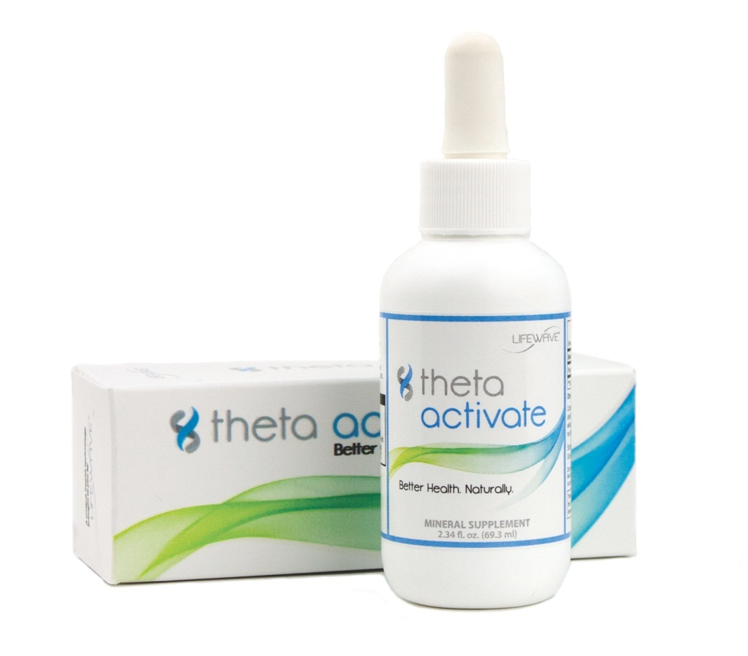
Imagine a technology that causes nutrients to go to work within minutes of use. This is Theta Activate.

Slide 49



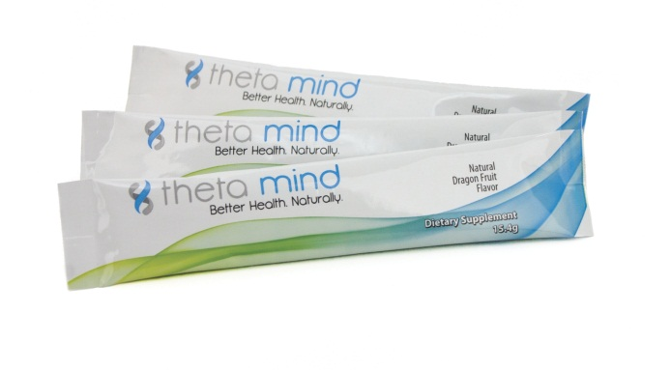
Activate your theta formulas for superior effectiveness and results you can feel in as little as a few minutes
23 drops

Slide 50
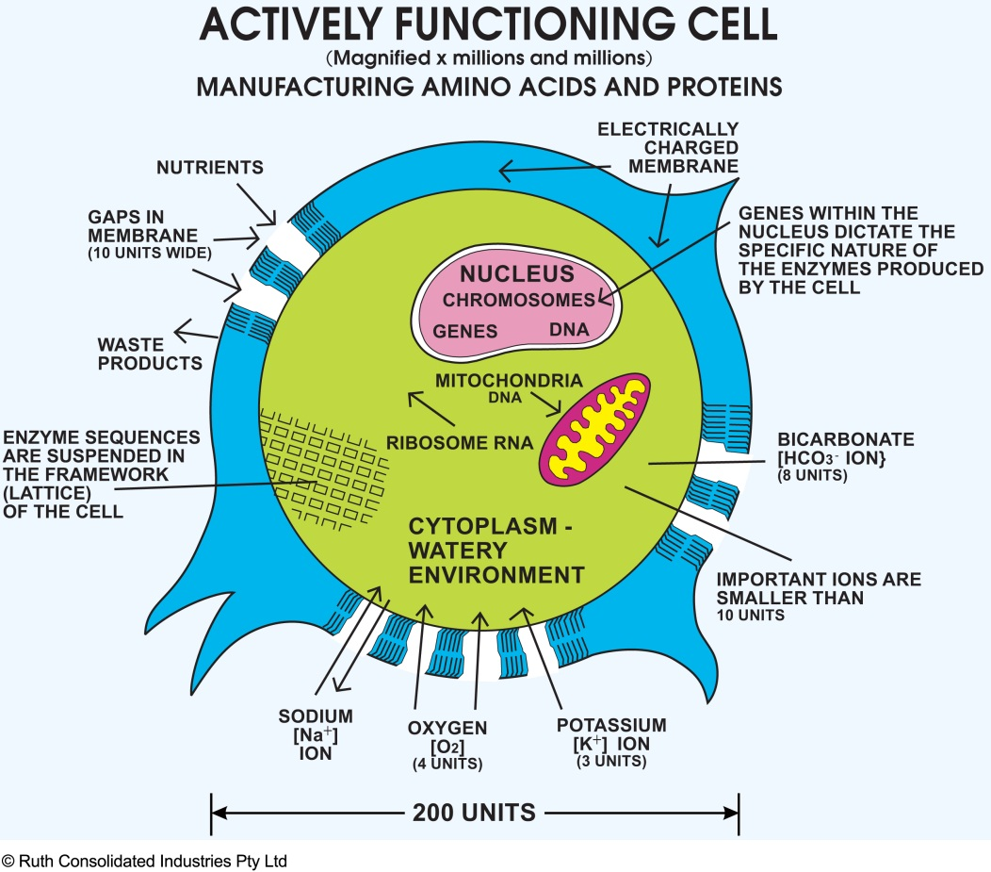
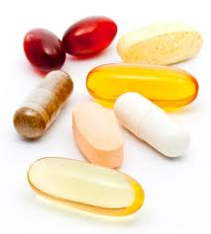
Most vitamin pills and juices take weeks to experience the benefits, if at all.
X
Most nutrients cannot easily enter the cells of the body

Slide 51

Theta Mind + Theta Activate easily enters the cells and is metabolized rapidly

Slide 52

When the LifeWave Theta Mind formula is combined with Theta Activate over 90% of users experience effects such as improved clarity of mind, increased alertness and increased energy within minutes of use.
The formula is designed like a symphony, where all components converge together to produce rapid cellular absorption of the nutrients. The aim is to resupply four natural brain compounds that are often depleted in many individuals.
David calls it the technology,
but I call it the “magic”

Slide 53
The proprietary activation system in theta allows the nutrients to enter the cells more rapidly, producing benefits you can experience
NOW, not in weeks or never

Slide 54
Theta activate is a special form of silica, a nutrient needed by your body for the health of connective tissue, hair, nails and skin

Slide 55
Simply add the Activate liquid to your theta formula, and you have now “turbocharged” the formula; results within minutes!

Slide 57
I HAVE ONLY
LEFT OUT
ONE THING…

Slide 58
THE TASTE

Slide 59
All Theta Products have:
• No artificial
sweeteners
• No artificial colors
• No preservatives
• No artificial flavors
• No GMO’s, No Gluten

Slide 60
Just flavors from natural fruit sources for a taste that will have you looking forward to taking your nutrition each day

